Slide 1
Variables sampling inspection scheme for resubmitted lots based on the process capability index C pk.
European Journal of Operational Research, 217(3), 560-566.
Wu, C. W., Aslam, M., & Jun, C. H. (2012).

Slide 2
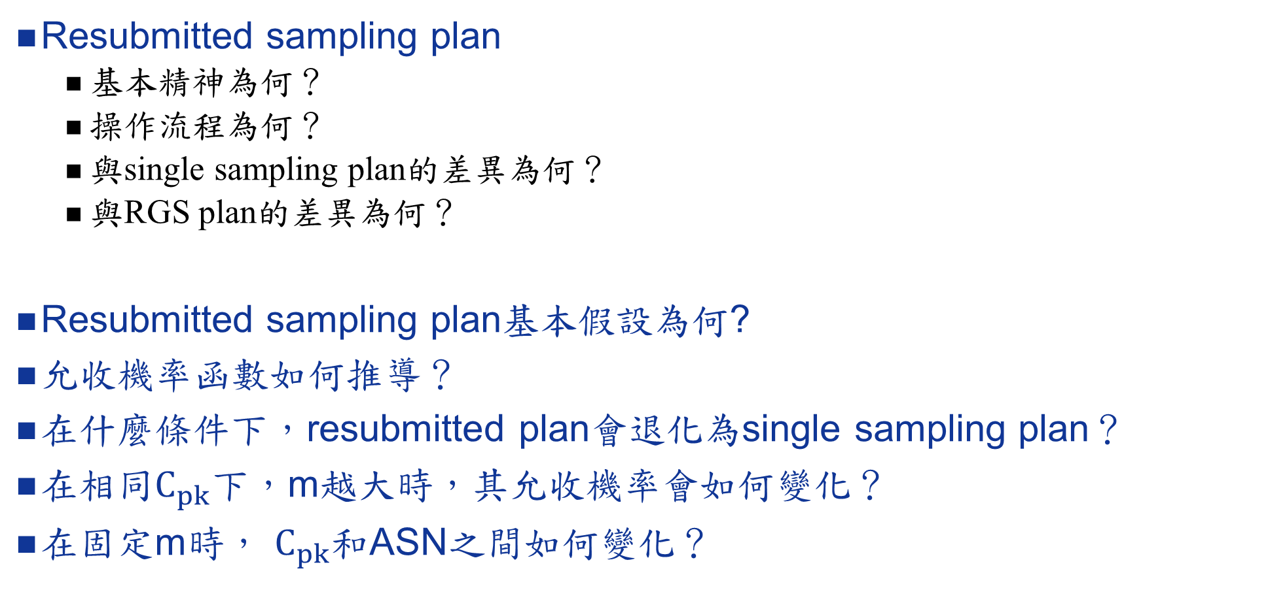
基本觀念/問題思考
Resubmitted sampling plan
基本精神為何？
操作流程為何？
與single sampling plan的差異為何？
與RGS plan的差異為何？
Resubmitted sampling plan基本假設為何?
允收機率函數如何推導？
在什麼條件下，resubmitted plan會退化為single sampling plan？
在相同$C_{pk}$下，m越大時，其允收機率會如何變化？
在固定m時， $C_{pk}$和ASN之間如何變化？

Slide 3
程式練習
完成表一到表三
完成圖一和圖二

Slide 4
A Sampling Scheme for Resubmitted Lots Based on One-Sided Capability Indices.
Quality Technology & Quantitative Management, 12(4), 501-515.
Kurniati, N., Yeh, R. H., & Wu, C. W. (2015).

Slide 5
程式練習
[5] 單邊製程能力指標之Single Sampling Plan的推廣
完成表一到表三
完成圖二

Slide 6
補充-resubmitted sampling plan
Govindaraju, K., & Ganesalingam, S. (1997). Sampling inspection for resubmitted lots. Communications in Statistics-Simulation and Computation,26(3), 1163-1176.

